Slide 1
Lecture 12 - Adaboost
Dr. Sifat Momen

Slide 2
AdaBoost
One way for a new predictor to correct its predecessor is to pay a bit more attention to the training instances that the predecessor underfit.
This results in new predictors focusing more and more on the hard cases.
This is the technique used by AdaBoost
Boosting algorithms such as adaboost is different from bagging algorithms in many ways:
Bagging trains models independently while boosting trains models sequentially
Bagging assigns equal weights to all models while boosting assigns higher weights to models that perform better
Bagging is easier to parallelize because models are trained independently, while boosting is harder to parallelize

Slide 3
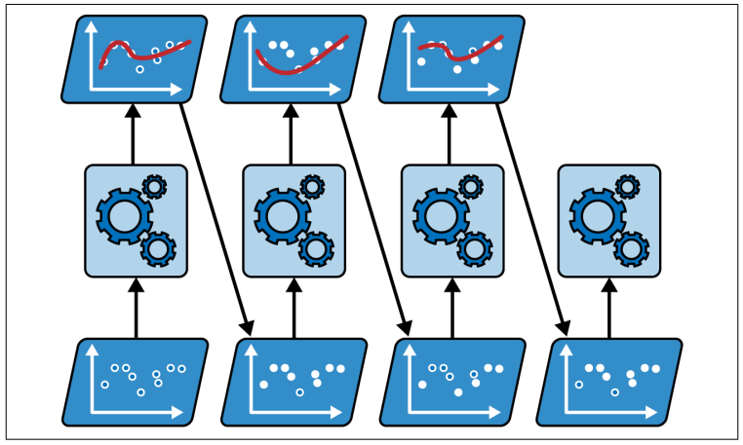
AdaBoost

Slide 4
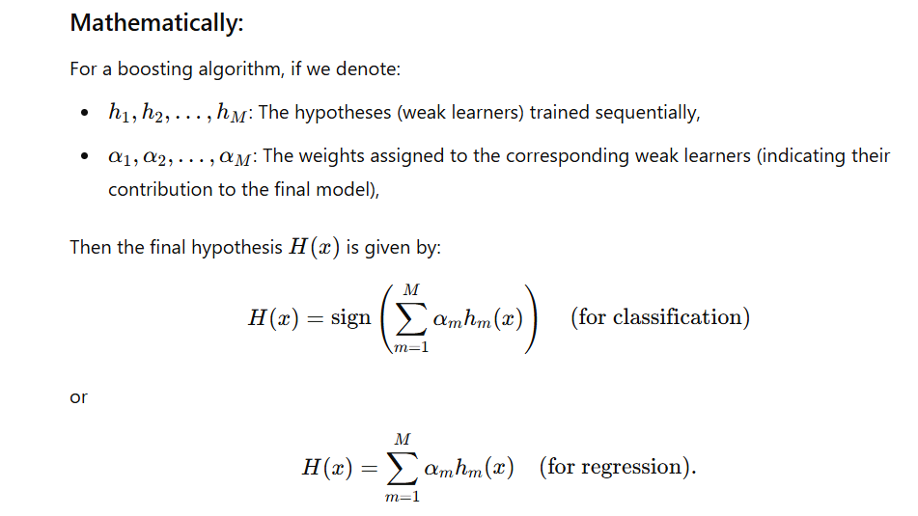

Slide 5
Steps
Step 1: Initialize sample weights
Step 2: Identify the feature based on which the decision stump will be made
Step 3: Determine the voting power
Step 4: Update the weights and normalize them
Step 5: Create Buckets
Step 6: Prepare a fresh dataset for the next weak learner
Repeat

Slide 6
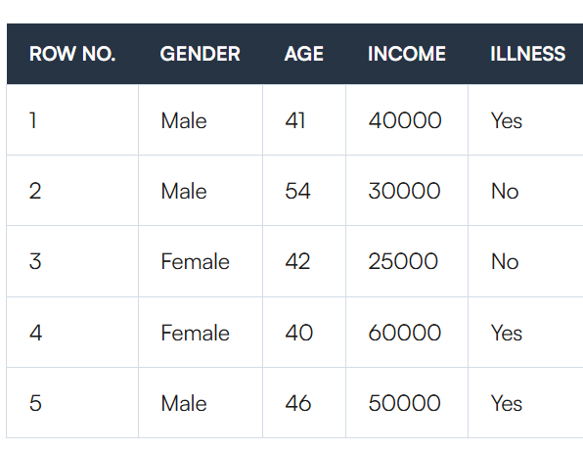
Dataset

Slide 7
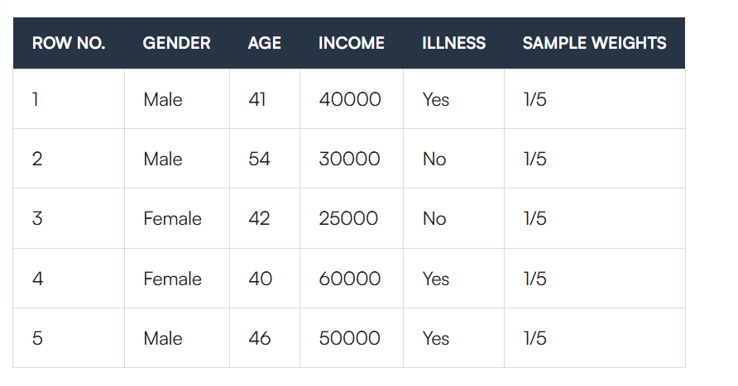
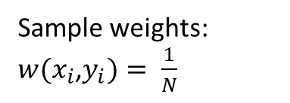
Step 1 - Initialize sample weights
Sample weights:
$w(x_{i}$,$y_{i})= \frac{1}{N}$

Slide 8
Step 2 – Identify the feature based on which the decision stump will be applied
We'll make a decision stump for each characteristic and then compute each tree's Gini Index/Entropy
Our first stump will be the tree with the lowest Gini Index/Entropy.

Slide 9
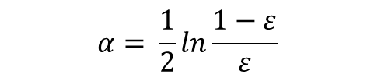
Step 3 – Determine the voting power
$$α= \frac{1}{2}ln\frac{1−ε}{ε}$$
Voting power = α, error rate = ε

Slide 10
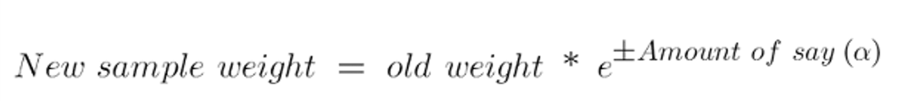
Step 4 – Update the Weights and Normalize
For correctly classified samples, it’s importance will be reduced by reducing the respective sample weights
For incorrectly classified samples, it’s importance will be increased by increasing the respective sample weights

Slide 11
Step 5 – Create bins/buckets
Use the concept of cumulative sample weights

Slide 12
Step 6 – Prepare a fresh dataset for the next weak learner.
Use the concept of random numbers to create the new dataset

Slide 13
Example
Create an Adaboost model with 3 decision stumps (weak learners) for the following dataset. Use gini as a measure of impurity
Temperature | Windy | Humidity | Play?
High | No | Yes | N
Low | Yes | No | Y
High | Yes | Yes | N
High | No | Yes | Y
Low | Yes | Yes | Y
High | Yes | No | N

